Slide 1
TRAFFIC ANALYSIS BASED INTRUSION DETECTION SYSTEM FOR WIRELESS SYSTEMS USING GNN
MAJOR OBJECTIVE
To design and develop Traffic analysis based Intrusion Detection System for wireless systems using GNN to resolve novel attack issues, Less powerful beyond classification problems and to improve accuracy.
SUB-OBJECTIVE
1.To analyse and predict the traffic of network for improving security thereby reducing novel attacks.
2.To analyse network traffic for long-term to avoid less powerful beyond classification problems.
3.To improve accuracy using GNN.

Slide 2
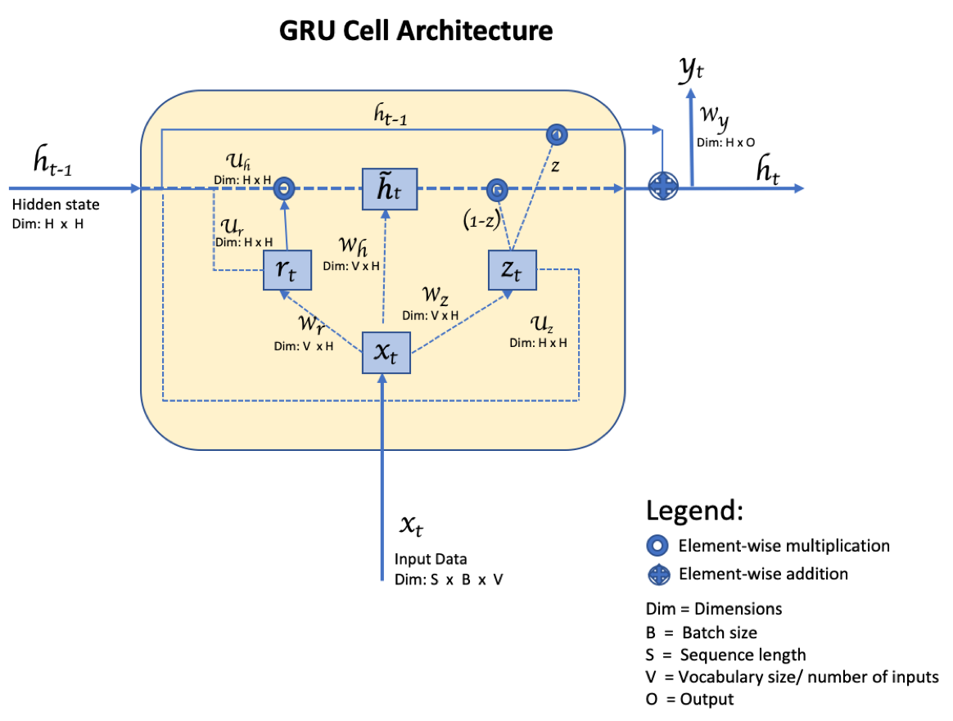

Slide 3
LitERATURE SURVEY
1)Jianguo Yu and Pei Tian, "Research and Design of Subway BAS Intrusion Detection Expert System",2018 IEEE 3rd Advanced Information Technology, Electronic and Automation Control Conference(IAEAC 2018).
METHODOLOGY: Building Automation System.
ISSUE RESOLVED: The system is used to identify anomalous attacking and prevent the system by the defined rule.
FUTURE WORK: At present, this system is only an exploratory stage that has not yet been perfected.

Slide 4
2)Anish Halimaa A and Dr. K.Sundarakantham,"MACHINE LEARNING BASED INTRUSION DETECTION SYSTEM", Proceedings of the Third International Conference on Trends in Electronics and Informatics (ICOEI 2019) IEEE Xplore Part Number: CFP19J32-ART; ISBN: 978-1-5386-9439-8.
METHODOLOGY: Machine Learning.
ISSUE RESOLVED: It deals with building an more effective model based on well-organised classifiers which are capable to categorise new attacks with better performance.
FUTURE WORK: Accuracy problem. Future work deals with large volume of data, a hybrid multi-level model will be constructed to improve the accuracy.

Slide 5
3)Dr. Manish Kumar and Ashish Kumar Singh, "Distributed Intrusion Detection System using Blockchain and Cloud Computing Infrastructure ",Proceedings of the Fourth International Conference on Trends in Electronics and Informatics (ICOEI 2020) IEEE Xplore Part Number: CFP20J32-ART; ISBN: 978-1-7281-5518-0.
METHODOLOGY: Blockchain and Cloud Computing Infrastructure.
ISSUE RESOLVED:The paper discussed the various wireless intrusion detection system and analysis the performance and listed the wireless system in detection rate.
FUTURE WORK:There are many other issues like communication delay, the overhead of blockchain, cost of implementation, etc. which has to be discussed and analyzed.

Slide 6
4)Vasaki Ponnusamy and Aun Yichietxt ,"IoT Wireless Intrusion Detection and Network Traffic Analysis", article DOI:10.32604/csse.2022.018801.
METHODOLOGY: Internet of Things.
ISSUE RESOLVED: The paper identified a set of high gain features that is highly correlated to network intrusion on wireless networks.

Slide 7
5)Akil krishna and Ashik lal M A ,"Intrusion Detection and Prevention System Using Deep Learning" ,Proceedings of the International Conference on Electronics and Sustainable Communication Systems (ICESC 2020) IEEE Xplore Part Number: CFP20V66-ART; ISBN: 978-1-7281-4108-4.
METHODOLOGY: Deep Learning.
ISSUE RESOLVED: The authors build the IDPS Research Tool, which will be able to detect and prevent intrusions from intruders.

Slide 8
SUMMARY OF ISSUES
1) To address anomalous attacking and prevent the system by the defined rule.
2) Lack of more effective model based on well-organised classifiers which are capable to categorise new attacks with better performance.
3) Missing high gain features that is highly correlated to network intrusion on wireless networks.
4)Lack of optimization methods used in the functional components of neural networks for building an effective online traffic classification system.

Slide 9
PROPOSED SYSTEM
OBJECTIVE:
To design and develop Traffic analysis based Intrusion Detection System for wireless systems using GNN. Detecting intrusions with better accuracy is a nightmare while analyzing vast congested traffic. The objective here is "Analyzing and predicting the traffic of network will improve security".

Slide 10
SUB OBJECTIVES | ISSUES RESOLVED
1)To build IOT based Intrusion Detection system. | Able to handle high gain features that is highly correlated to network intrusion on wireless networks.
2) To build the IDPS Research Tool. | Will be able to detect and prevent intrusions from intruders.
3)Usage of GNN(Graph Neural Network). | Improves accuracy and reduces complexity.

